Slide 1
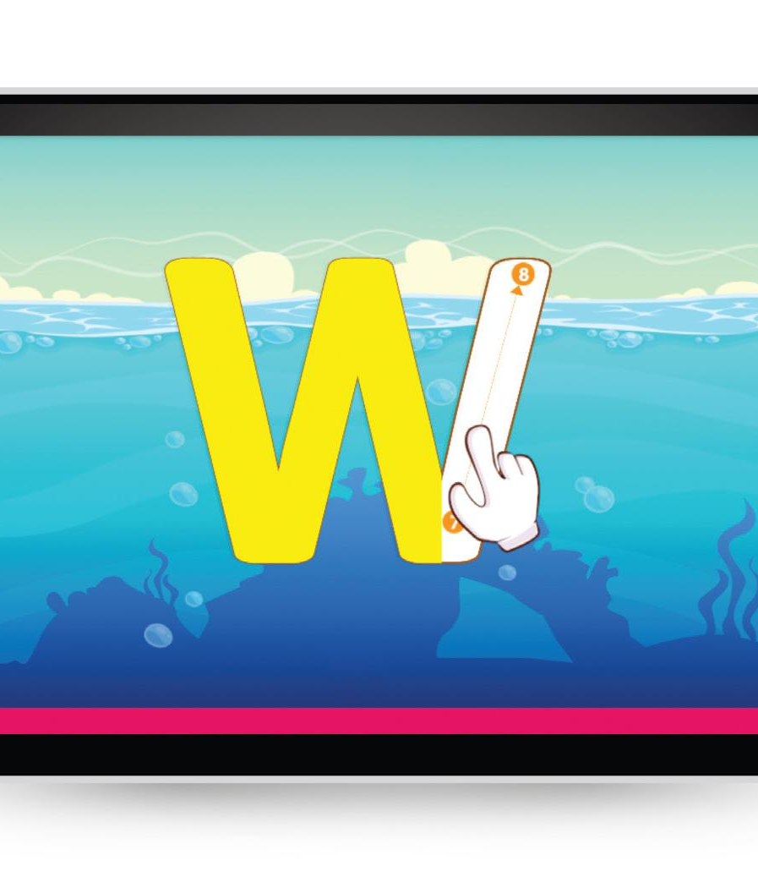






World Book
Early Learning
Inform • Learn • Engage
Notes:
These slides were provided by and created by World Book. INFOhio added a few directional slides to help users know how to get to the resources and how to learn more through the Learning Pathways Classes.

Slide 2

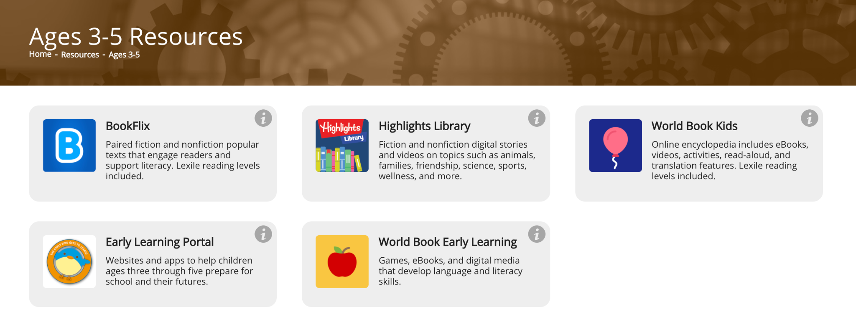
Notes:
*This slide has animation. Use Present mode to view.*
To find the World Book Early Learning resource on the INFOhio website go to the INFOhio homepage: https://www.infohio.org. Click the Ages 3-5 button or Grades K-5 button. The i button will give further training and support for the resource, or click anywhere on the resource box to open the resource.

Slide 3
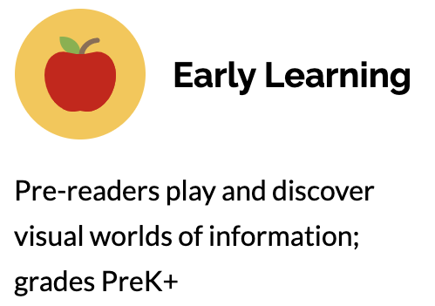
Site design
Developed with experts in Early Childhood education
Entire site has read-aloud capability
Easy to recognize icons and multiple access points allow even the youngest users to navigate independently
Word-by-word highlight during reading helps pre-emergent readers recognize words
Device agnostic - great on tablets!
Notes:
For more information/talking points, check here- https://infohio.org/resources/item/early-world-of-learning (INFOhio’s information page)

Slide 4
Content
14 Content Worlds cover high interest topics and serve as a child’s first digital encyclopedia
Videos, games, stories, and activities are perfect for disguised learning
Early Learning Basics, a section for building foundational skills such as letters, numbers, counting, and classification
Welcome to Reading, our guided reading program is a collection of 48 leveled books to help teach basic reading skills. Each comes with a lesson plan.
Notes:
For more information/talking points, check here- https://zoom.us/j/94398398277?from=addon

Slide 5
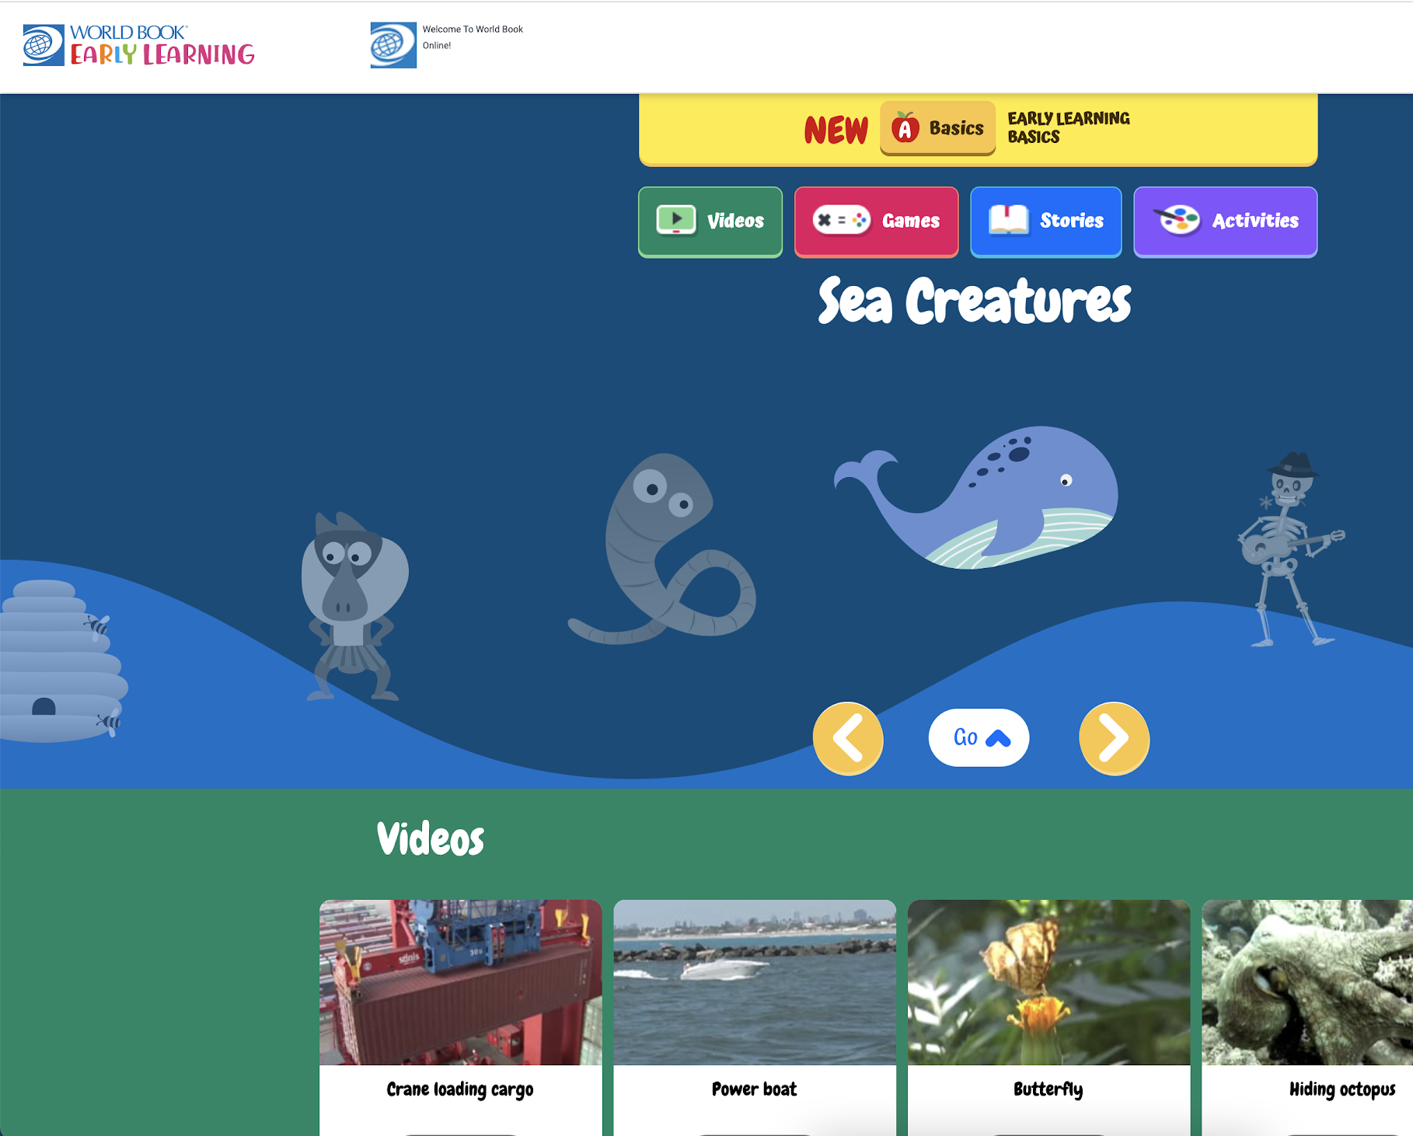
Features and tools to elevate learning

Slide 6
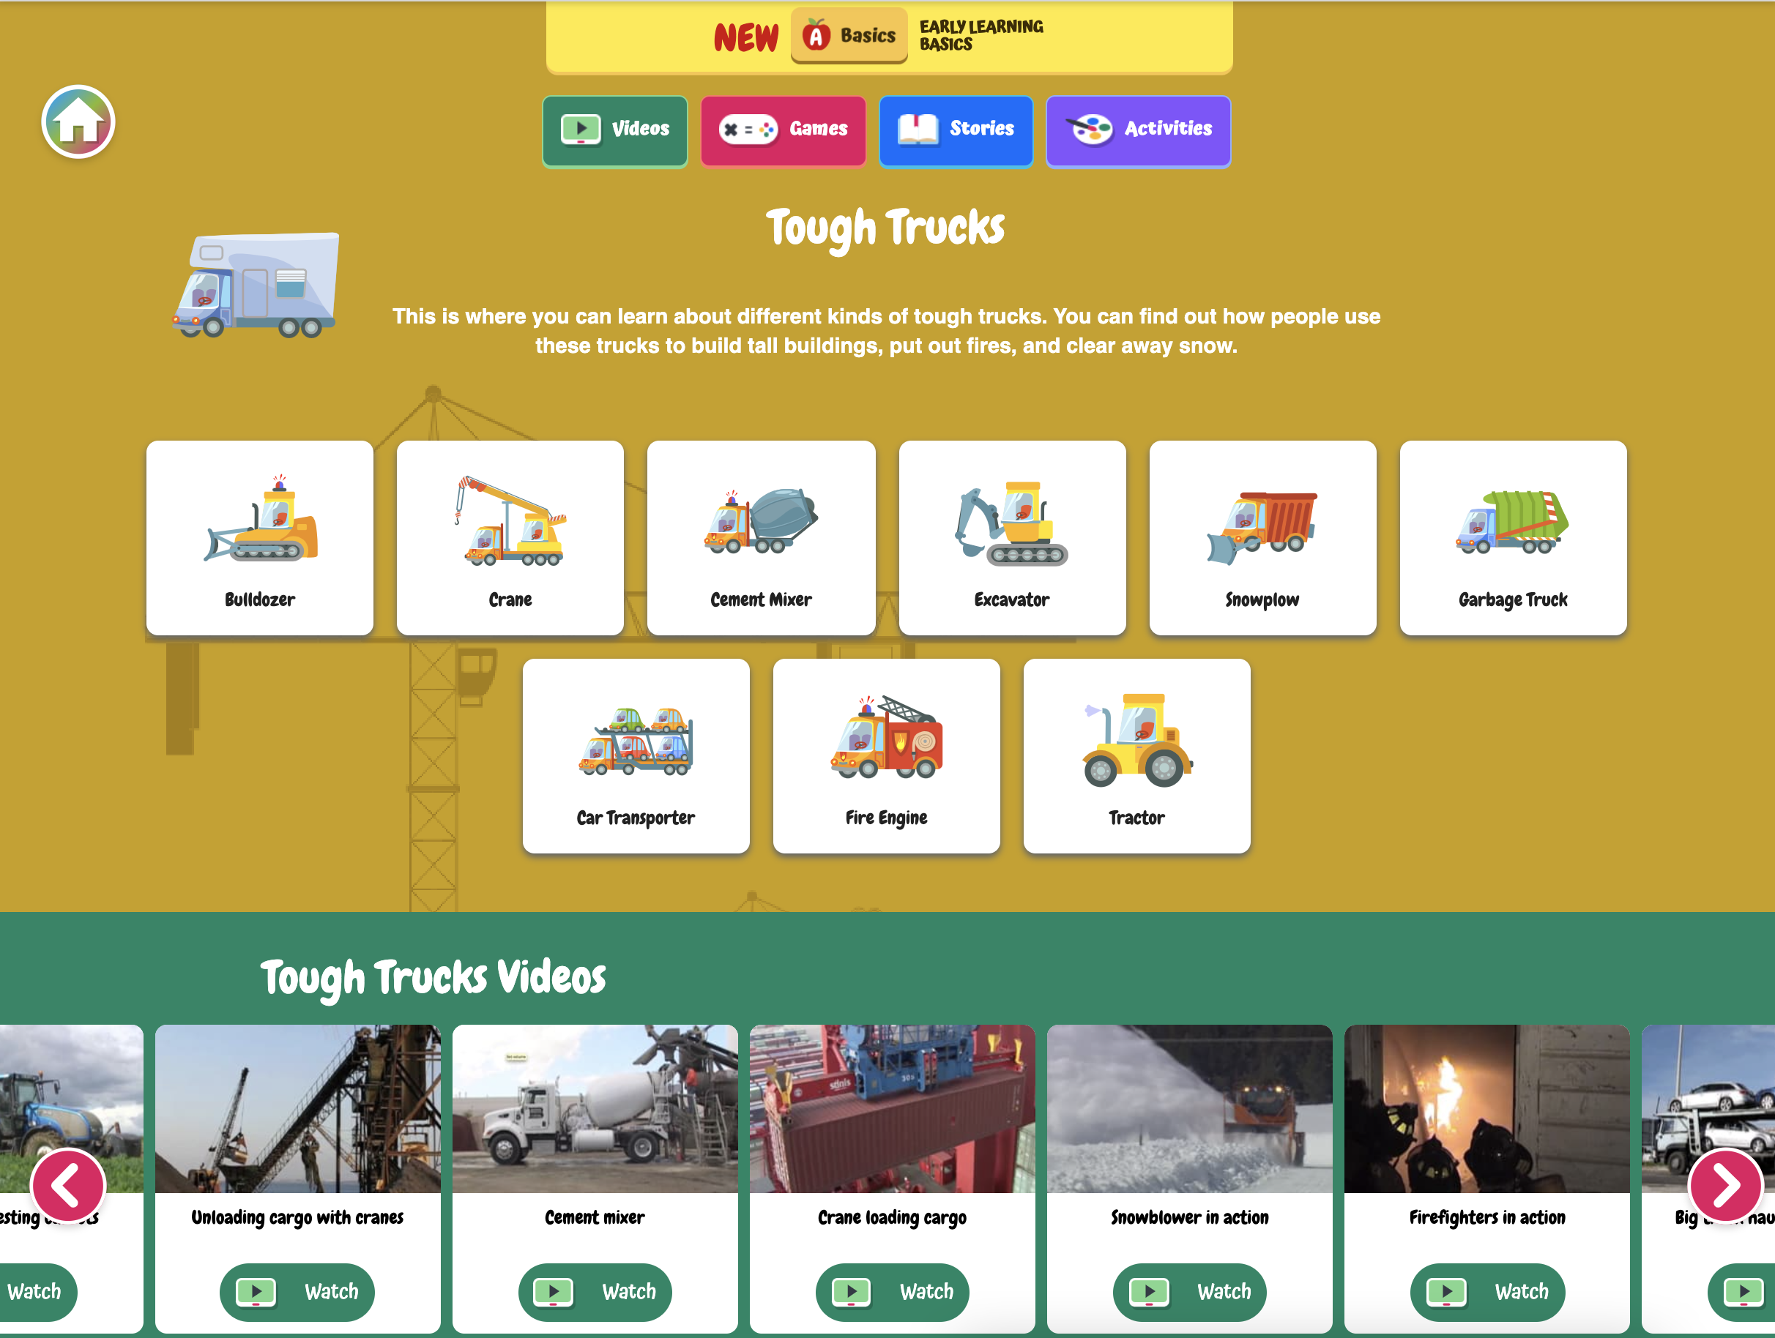
Content Worlds
14 categories related to the interests of young learners
Feature a wealth of expository content and serve as a child’s first interactive, visual online encyclopedia.
Consistent format between each content world
Explore topics through multiple formats

Slide 7
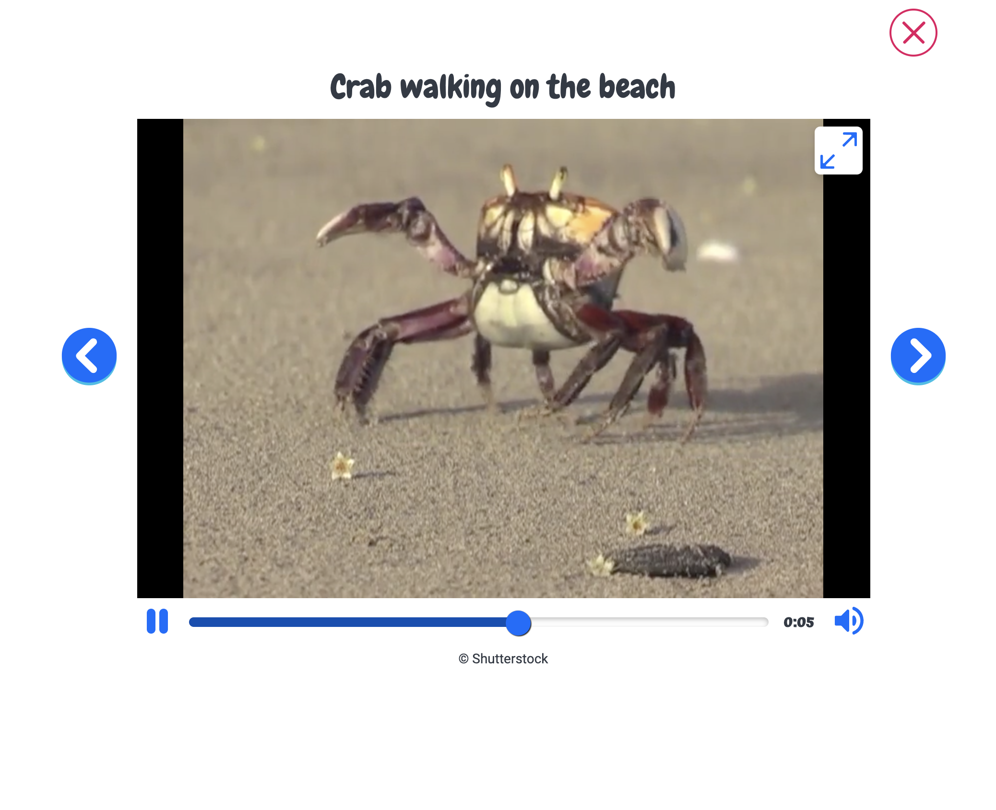
Videos
Organized by topic
Narrated and designed to provide visual, real-world examples of high-interest topics
Short in length to hold the attention span of young learners

Slide 8

Games
Tracing- numbers, letters, sight words
Matching- color and pattern recognition
Concentration- memory game
True or false- a fun way to learn new facts

Slide 9
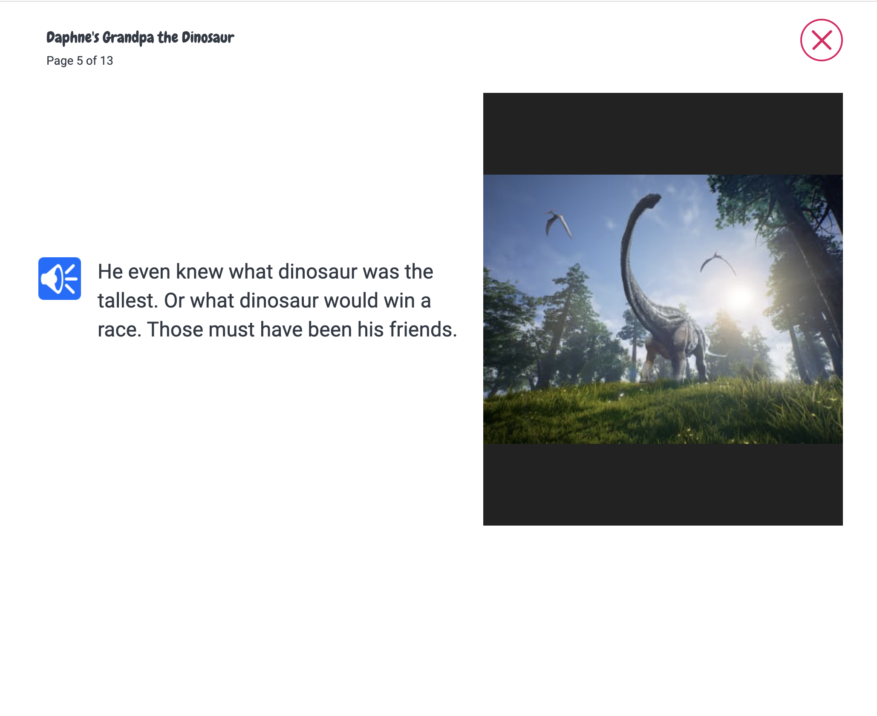
Stories
Find a variety of stories organized by topic.
  The 14 Content World’s plus fairy tales and fables, nursery rhymes, and stories in Spanish.
Every story can be read-aloud with the click of a button.

Slide 10
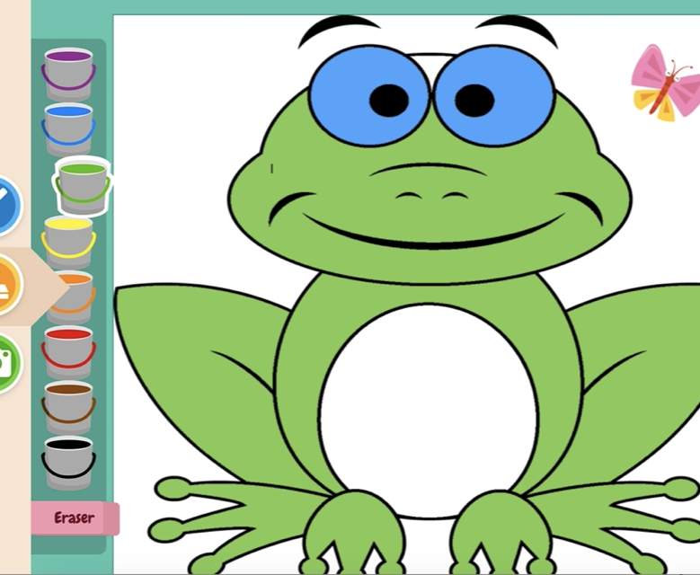
Activities
Digital coloring and free draw
Paint by number
Print and do

Slide 11
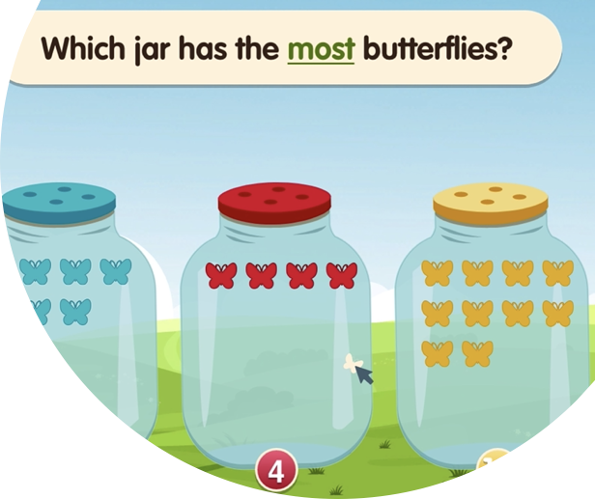
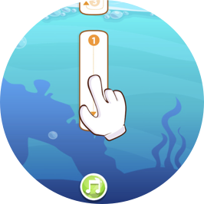
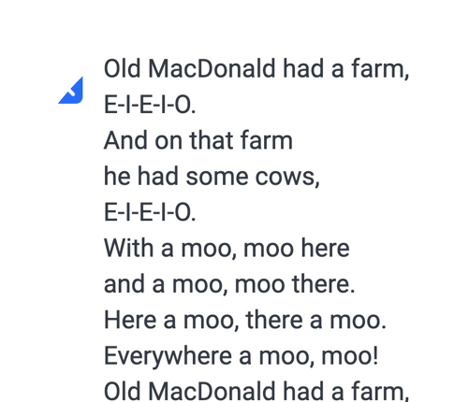

Early Learning Basics
Fun with words - learn the alphabet, practice writing letters and sight words
Count and play - learn numbers and basic counting skills
Once Upon a Time - digital texts with repetition and read-aloud
Welcome to Reading - guided reading program in digital format

Slide 12
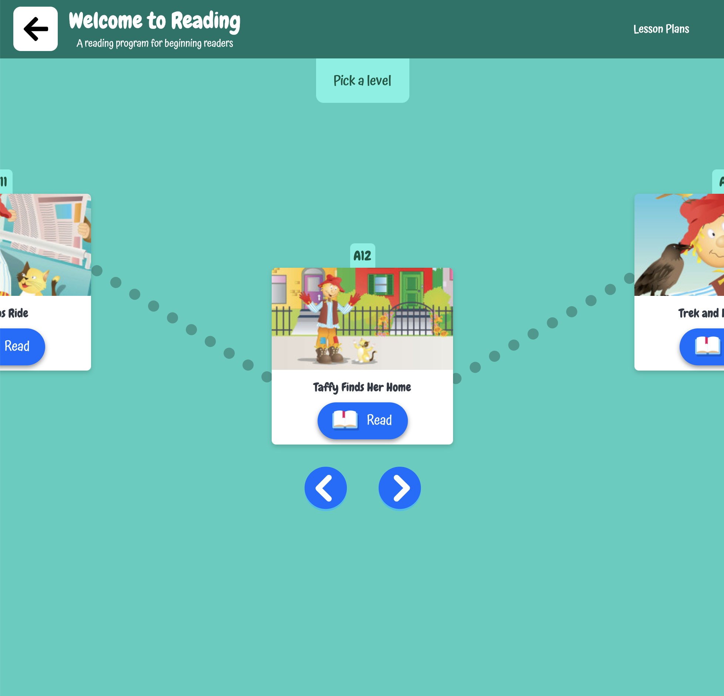
Welcome to Reading
Guided reading program
A collection of 48 engaging, leveled books
Arranged in sequential order by design
Accompanying lesson plans with vocabulary, phonics, activities, discussion ideas, and more

Slide 13
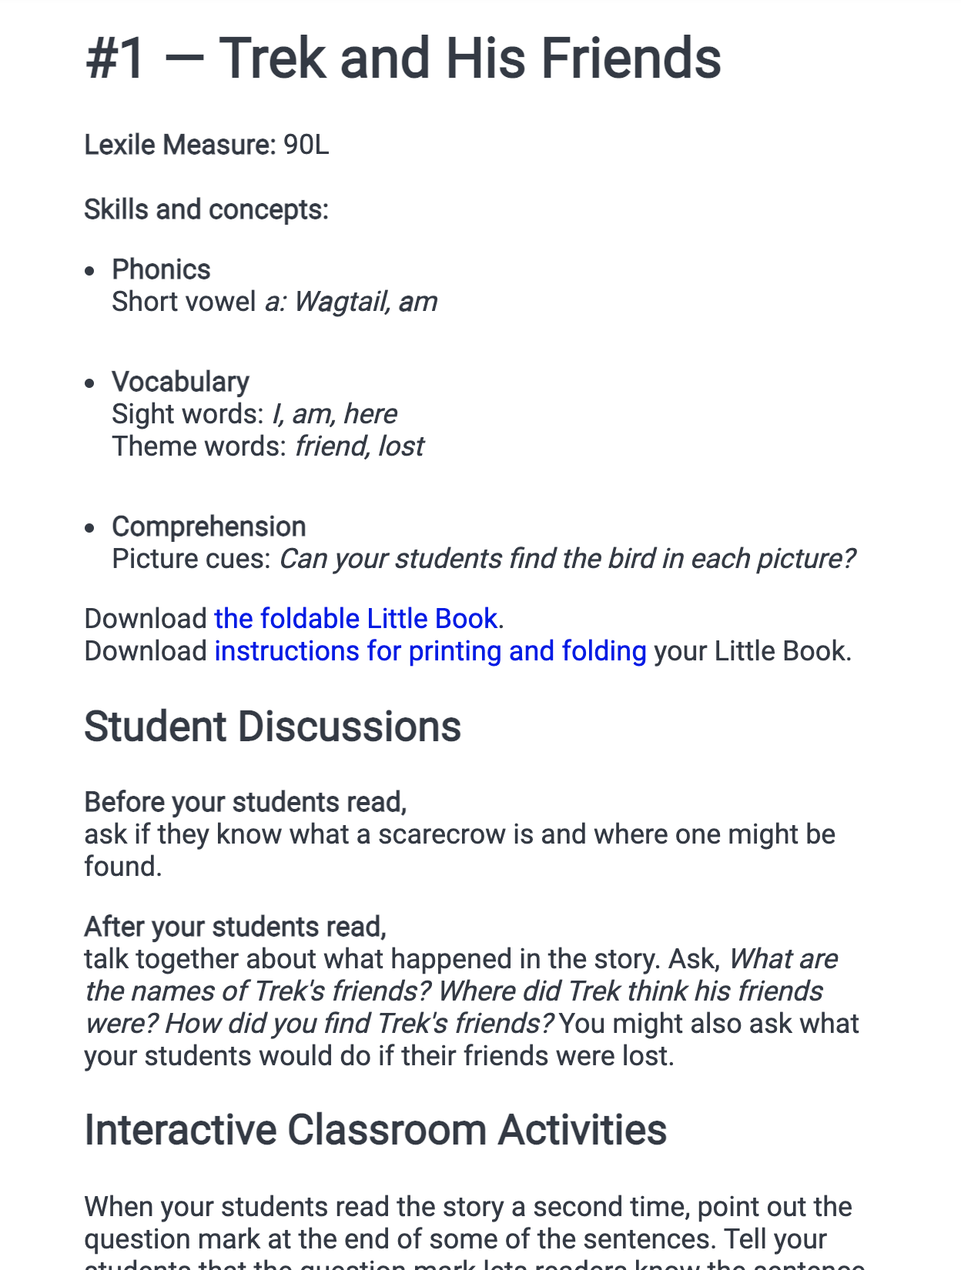
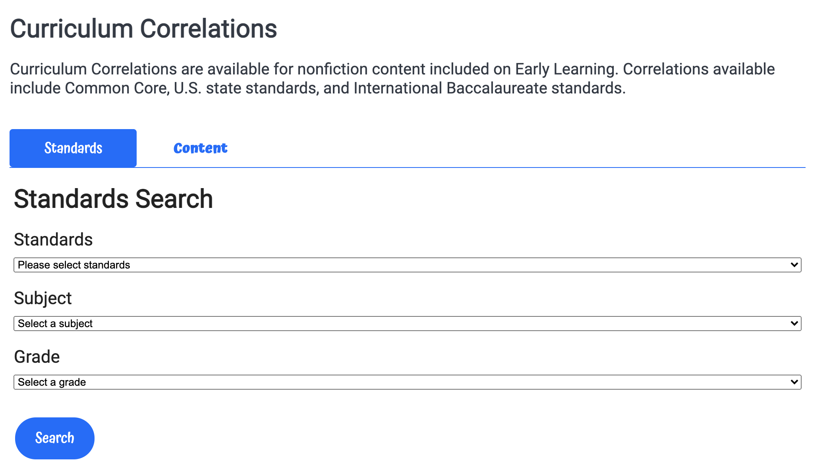
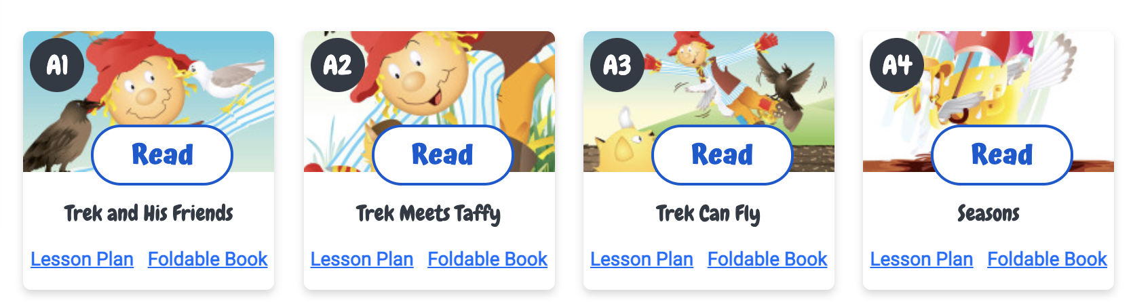
Educator Tools
AKA “For Grown-ups”
Search by standard
Printable version of the Welcome to Reading program
Lesson plans to accompany a selection of Trek titles
Featured section for new releases in Early Learning

Slide 14
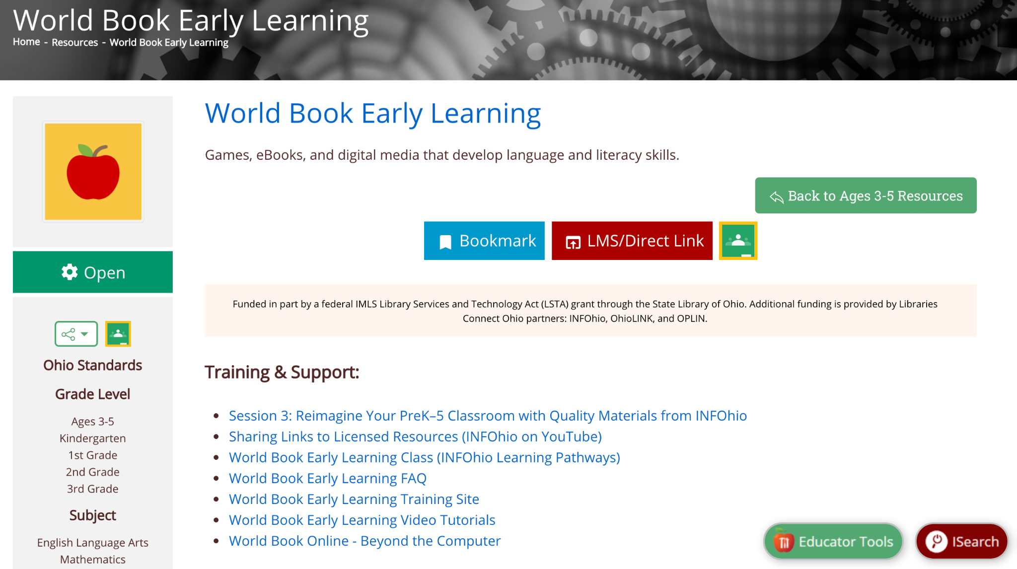
Ideas & Training
Notes:
https://infohio.org/resources/item/early-world-of-learning (INFOhio’s information page)

Slide 15
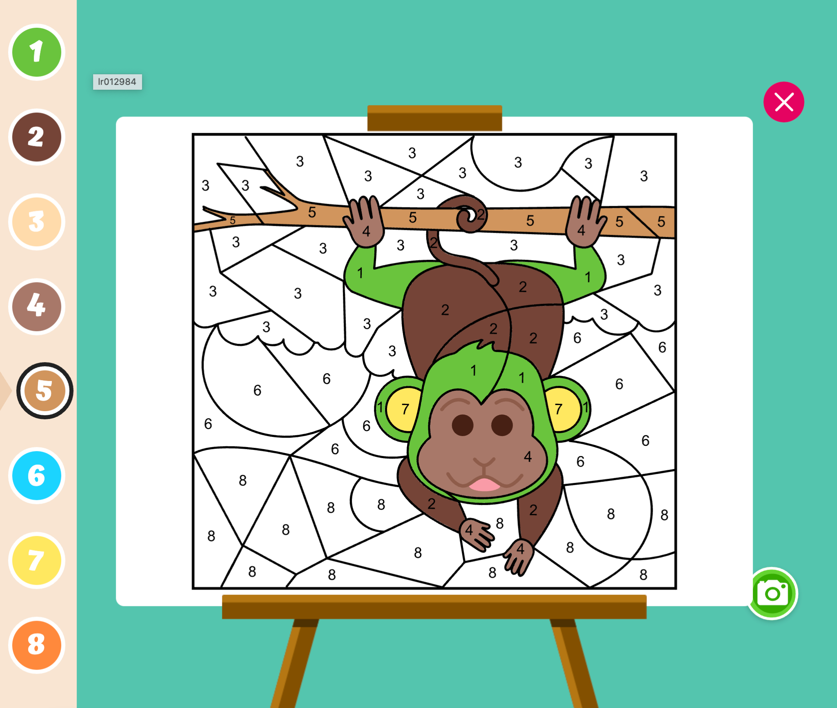
Ideas for Classroom Use
Build fine motor skills with Print and Do activities
Learn to write letters, numbers, and sight words with the Tracing games
Practice basic math facts with Paint by Number Activities
Learn how to speak and spell new words from the read-aloud function
Build fundamentals with Early Learning Basics
Have students share fun facts they learn watching videos and exploring pictures.

Slide 16
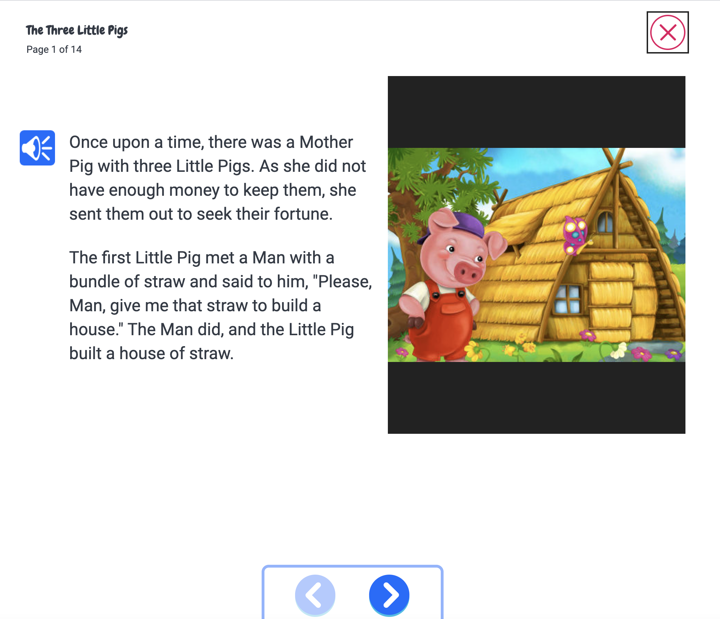
Ideas for Library Use
Read fairy tales and fables out loud during story time
Tie in pieces for summer reading programs
Print off activities to keep at activity stations
Tell parents about the guided reading program and Early Learning basics to help supplement instruction at home
Provide this as a resource for home school instruction

Slide 17
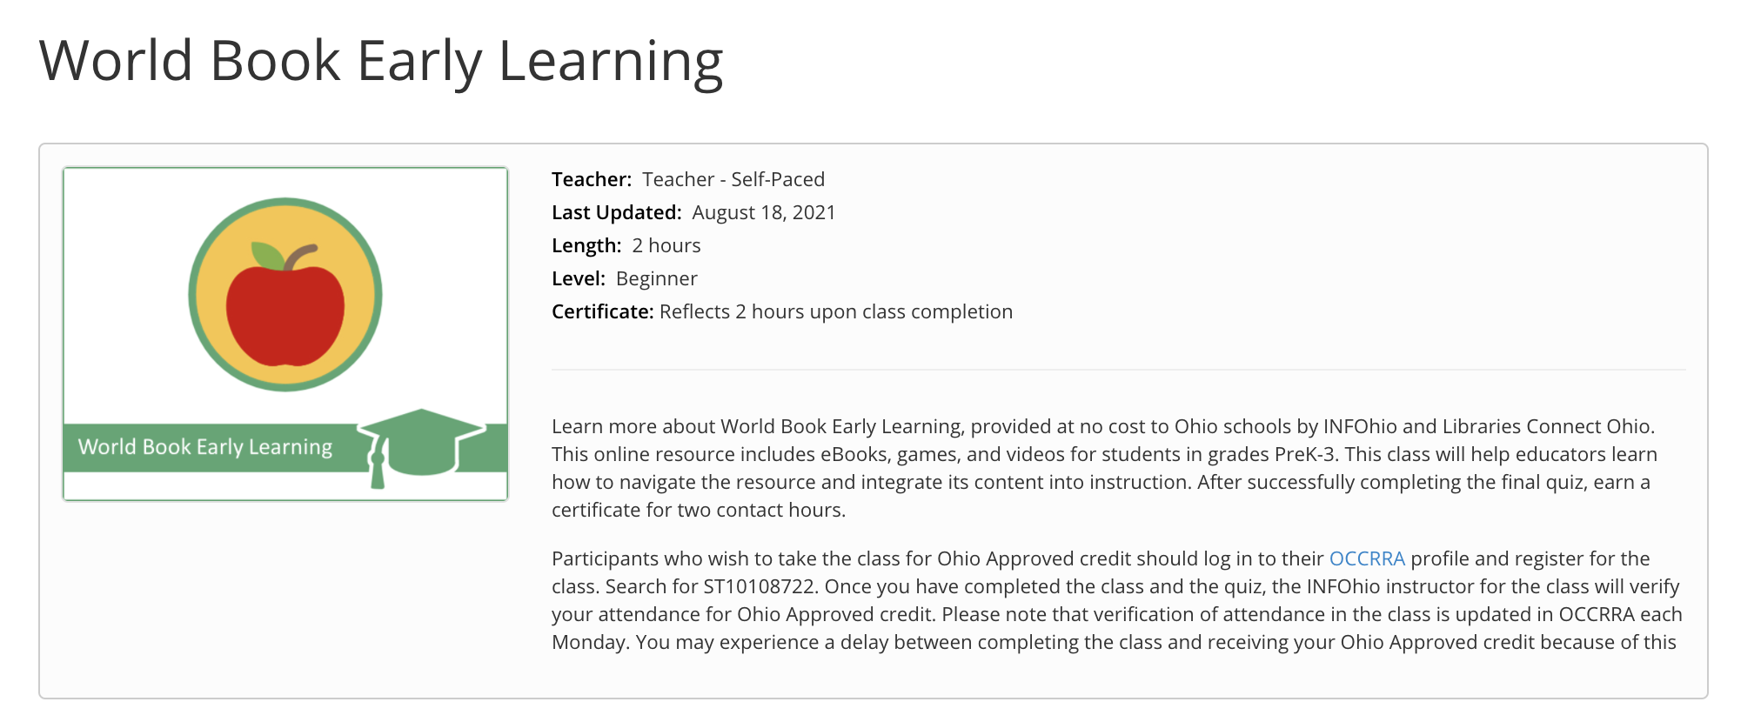
Learn More with INFOhio Classes
INFOhio Campus provides classes to help teachers integrate licensed resources into their classrooms.
Take this asynchronous, self-paced, World Book Early Learning Class and earn 2 contact hours after completion of the final quiz.
Notes:
https://infohio.org/campus/learning-pathways/course/world-book-early-learning

Slide 18
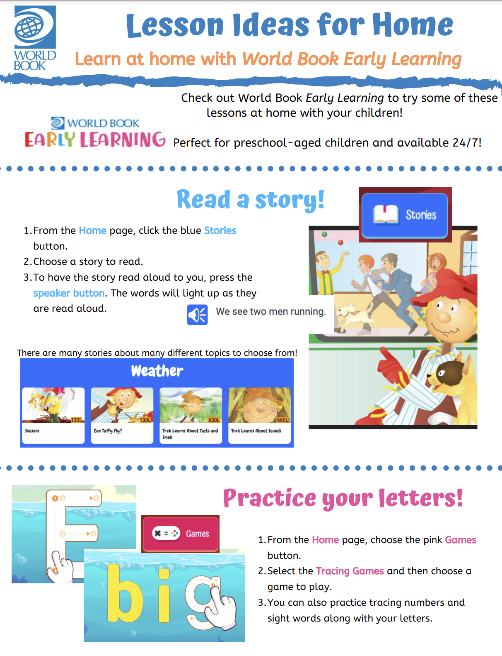
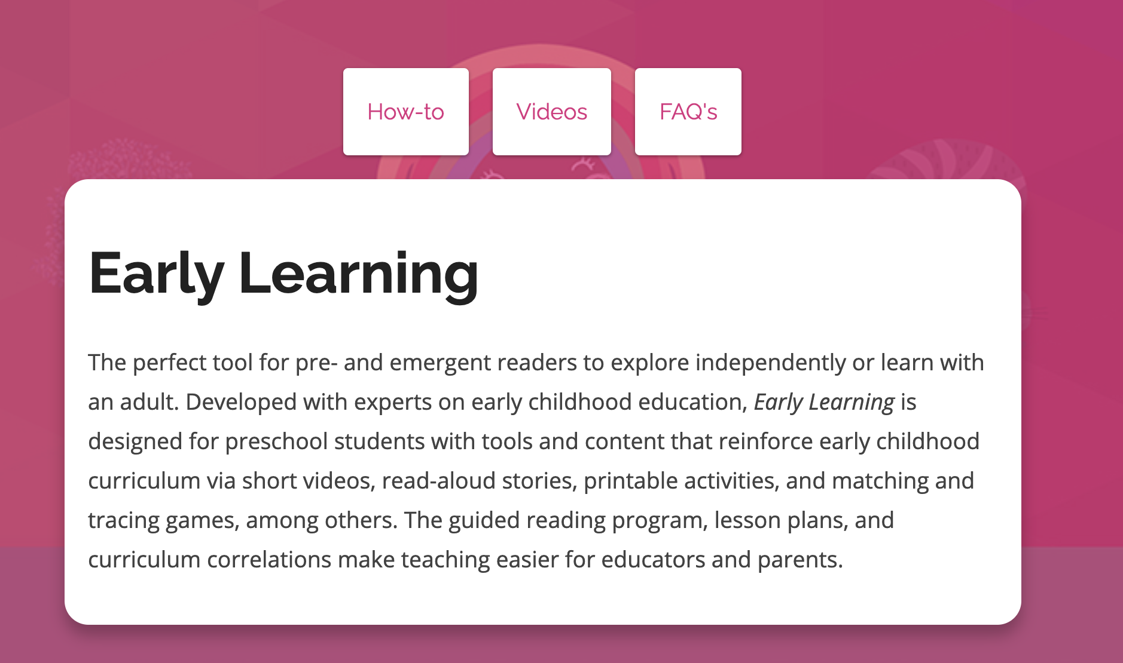

Training Material
Free promotional material such as colorful social media posts, bookmarks, flyers, and more!
How-to articles and tutorial videos on each feature of Early Learning
Ideas for use in the classroom & at home
Notes:
In addition to what you will find on the INFOhio information page for World Book Early Learning, World Book has additional videos and tutorials that may be helpful.

Slide 19
Presented by:
Contact Me!

